Slide 1
DIRECT MARKETING CAMPAIGNS OF A PORTUGUESE BANKING INSTITUTION
Group Meh
Burakhan Sel Mehmet Burak Çakır Mustafa Kemal Şaşmaz Sergen Tuğ Toraman

Slide 2
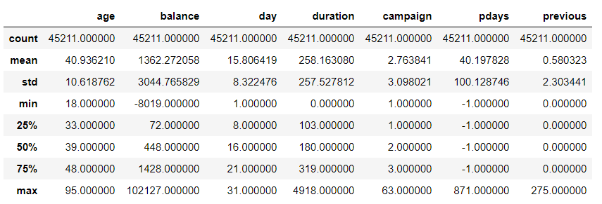
DATASET INTRODUCTION: NUMERICS

Slide 3
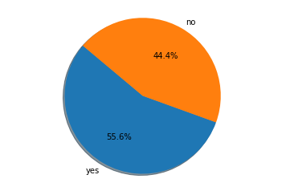
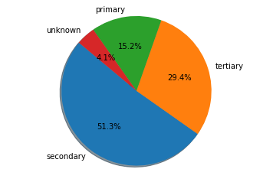
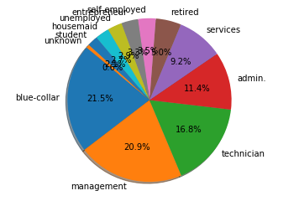
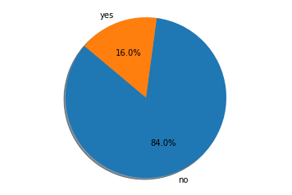
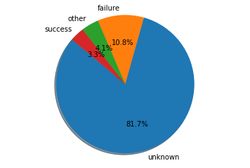
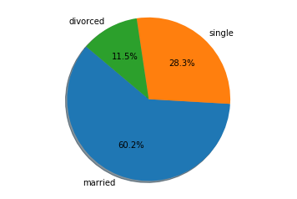
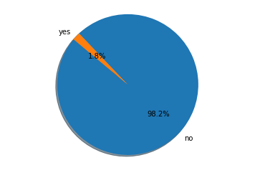
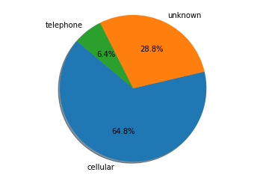
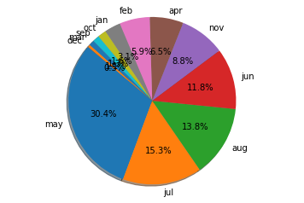
DATASET INTRODUCTION: CATEGORICALS
education
job
marital
month
loan
default
contact
housing
poutcome

Slide 4
DATA RESTRUCTURING
NAs are handled.
Extreme values are transformed.
Responses are converted to binaries.
Data is divided into two datasets: train and test.
Datasets are balanced via oversampling.
Binary dummies are created.
Continuous features are scaled/normalized.
Features and response are separated.

Slide 5
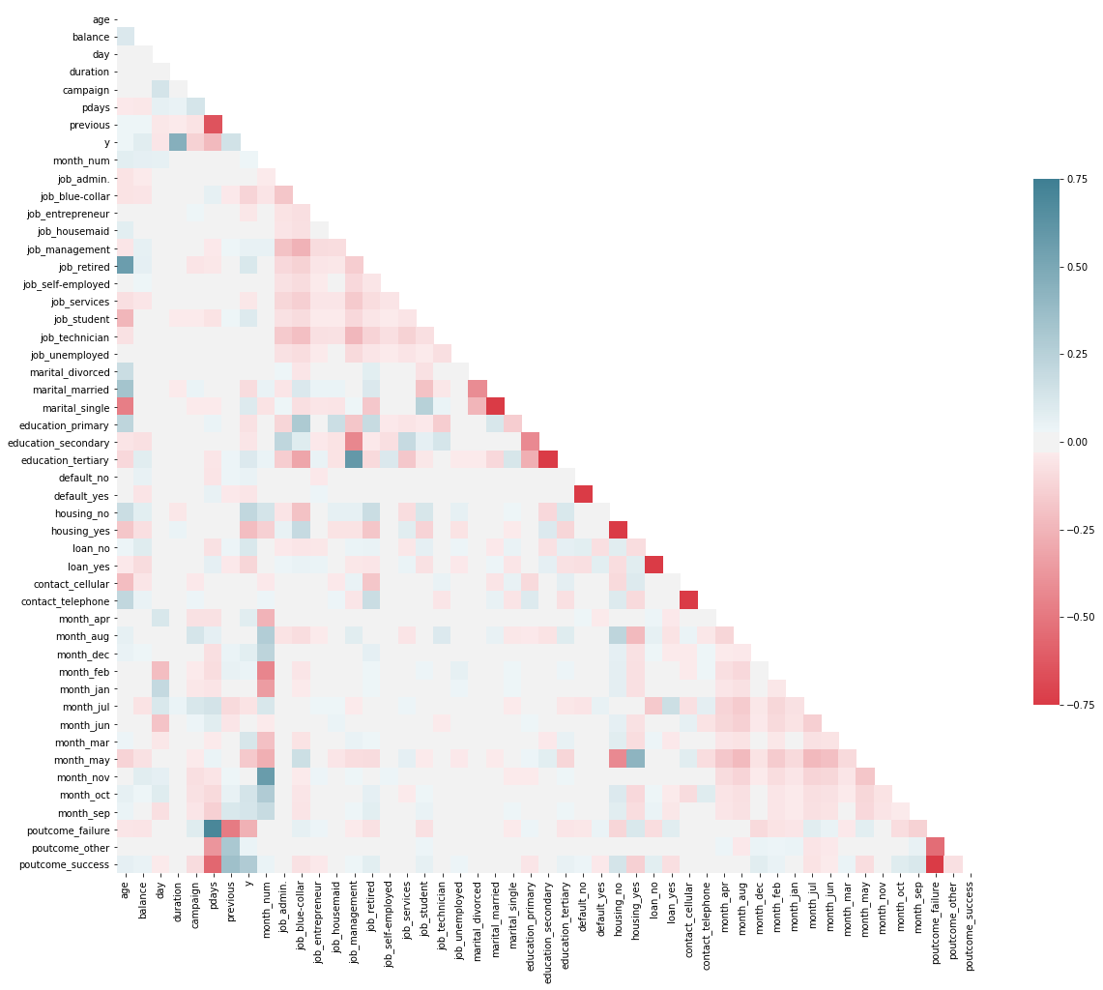
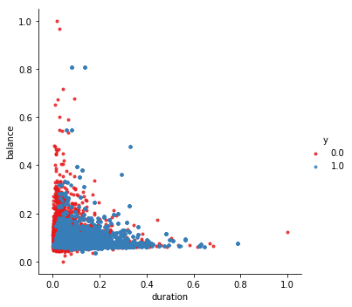
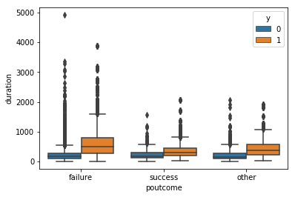
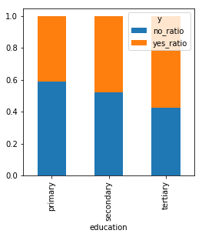
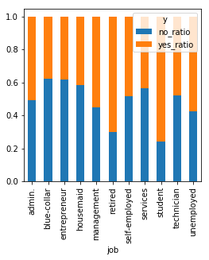
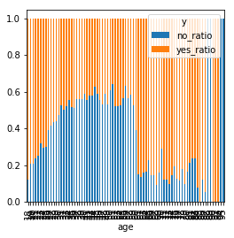
DATA EXPLORATION

Slide 6
METHODS REVIEW: ROADMAP
Feature Selection Methods
Logistic Regression
Random Forest (RF)
Classification Methods
Logistic Regression
Random Forest (RF)
Decision Tree (DT)
Gradient Boosting (GB)

Slide 7
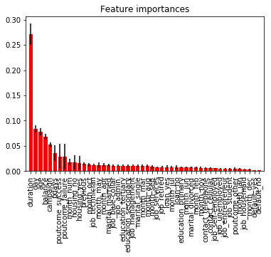
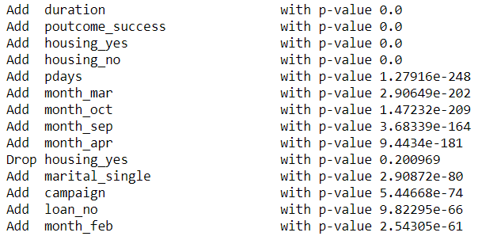
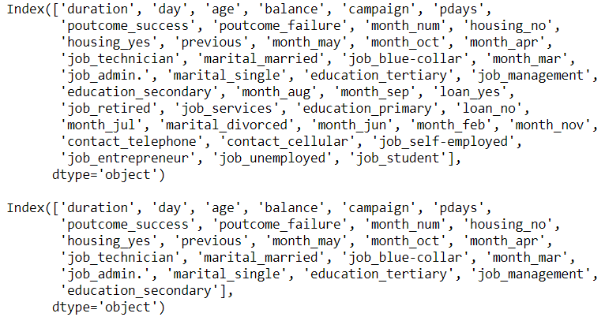
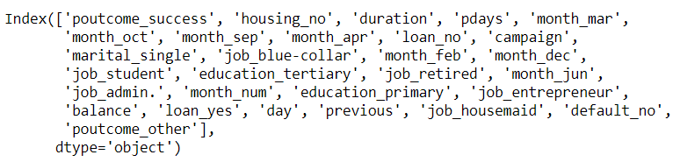
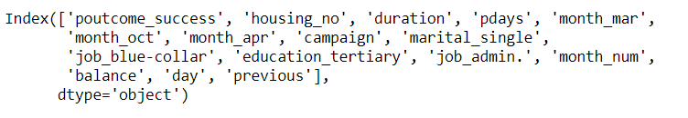
FEATURE SELECTION
Based on Logistic Regression Method
Mutual Features
Based on Random Forest Method

Slide 8
CLASSIFICATION METHODS
Dataset 1
RF_41
Logistic Regression
Parameter | Levels
Link Function | Probit | Logit
Random Forest
Parameter | Levels
n_estimators | 200 | 350 | 500
max_features | auto | sqrt
max_depth | 10 | 30 | 50 | None
min_samples_split | 2 | 5 | 10
min_samples_leaf | 1 | 2 | 4
bootstrap | True | False
Gradient Boosting
Parameter | Levels
Alpha | 0.1 | 1.0
Decision Trees
Parameter | Levels
criterion | 4 | 10 | 30
min_samples_leaf | 10 | 20 | 30
Dataset 2
RF_24
Dataset 3
Logreg
Dataset 4
mutual

Slide 9
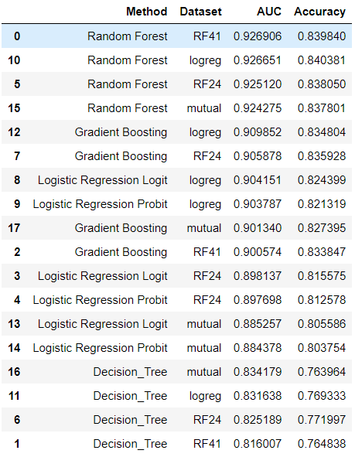
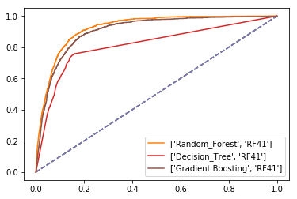
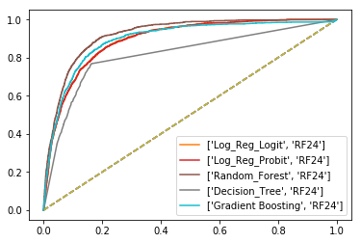
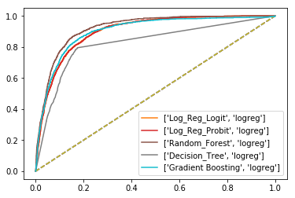
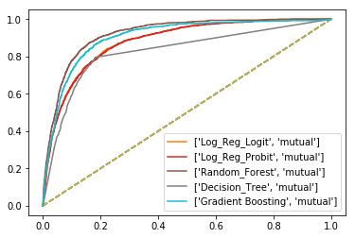
CLASSIFICATION METHODS: COMPARISON

Slide 10

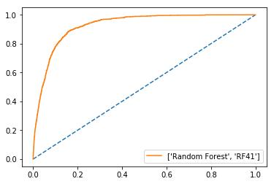
THE BEST MODEL: RANDOM FOREST
Random Forest
Parameter | Levels
n_estimators | 200 | 350 | 500
max_features | auto | sqrt
max_depth | 10 | 30 | 50 | None
min_samples_split | 2 | 5 | 10
min_samples_leaf | 1 | 2 | 4
bootstrap | True | False

Slide 11
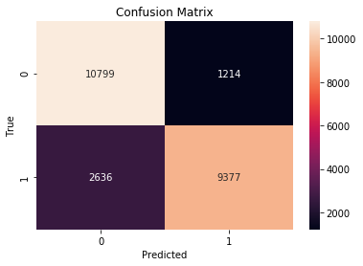
THE BEST MODEL: RANDOM FOREST
precision : [0.80379606 0.88537437]
recall : [0.89894281 0.78057105]
fscore : [0.8487111 0.82967616]

